Slide 1

Predicting Default Accounts

Slide 2
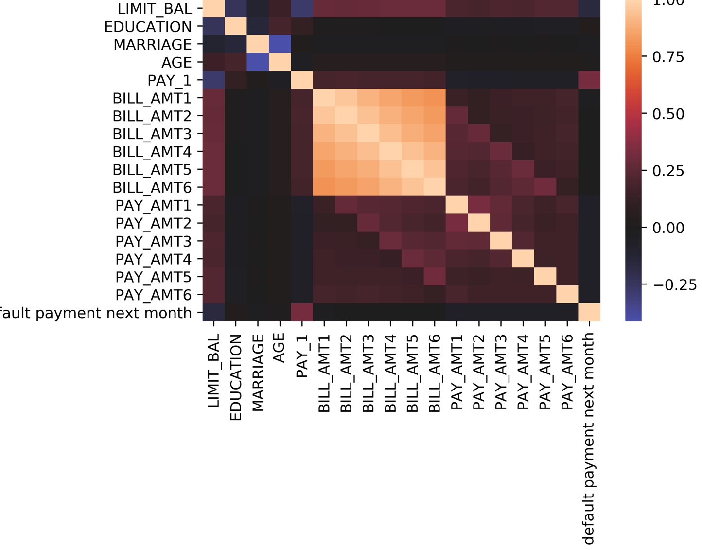
Correlation BETWEEN features
Most Correlated feature with response:
PAY_1
LIMIT_BAL

Slide 3
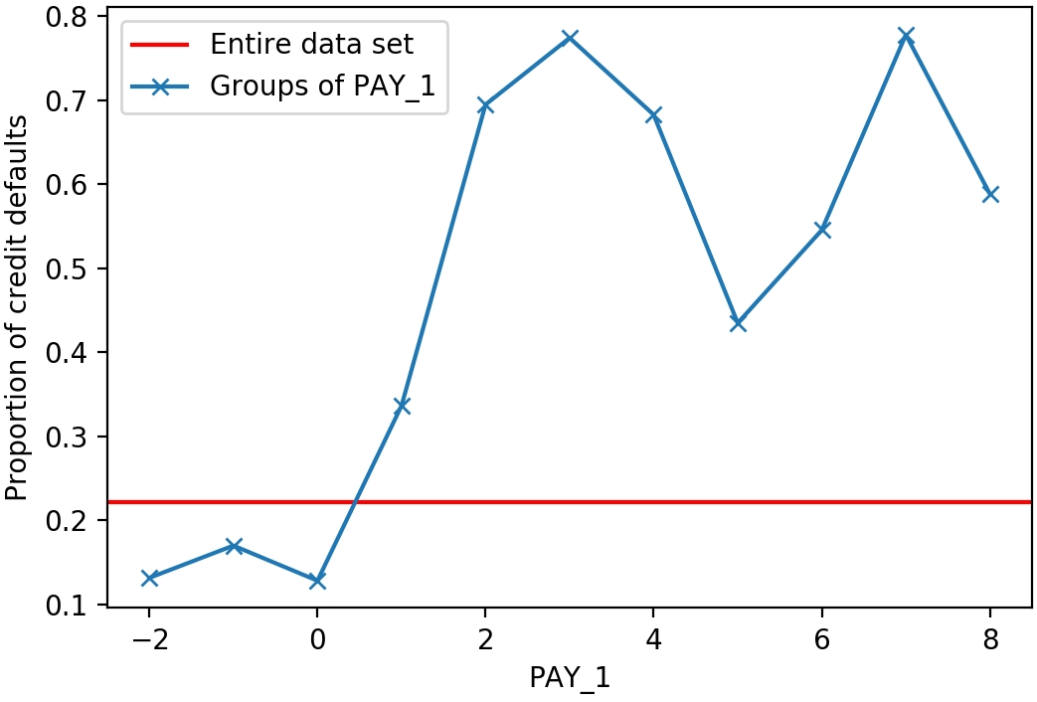
Tracing the Past
Overall default rate = 22%
At least 30% of the accounts that were in default last month tend to default again next month.

Slide 4
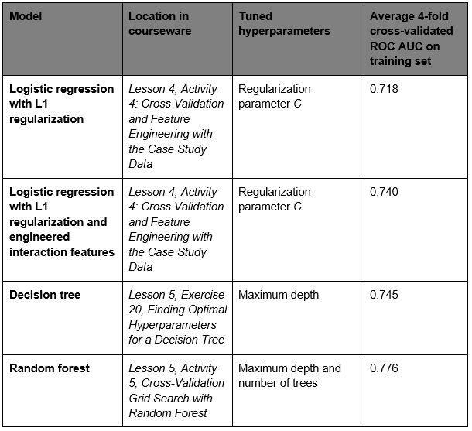
Modelling Activity summary
Random Forest turns out to be the best model for our dataset.

Slide 5
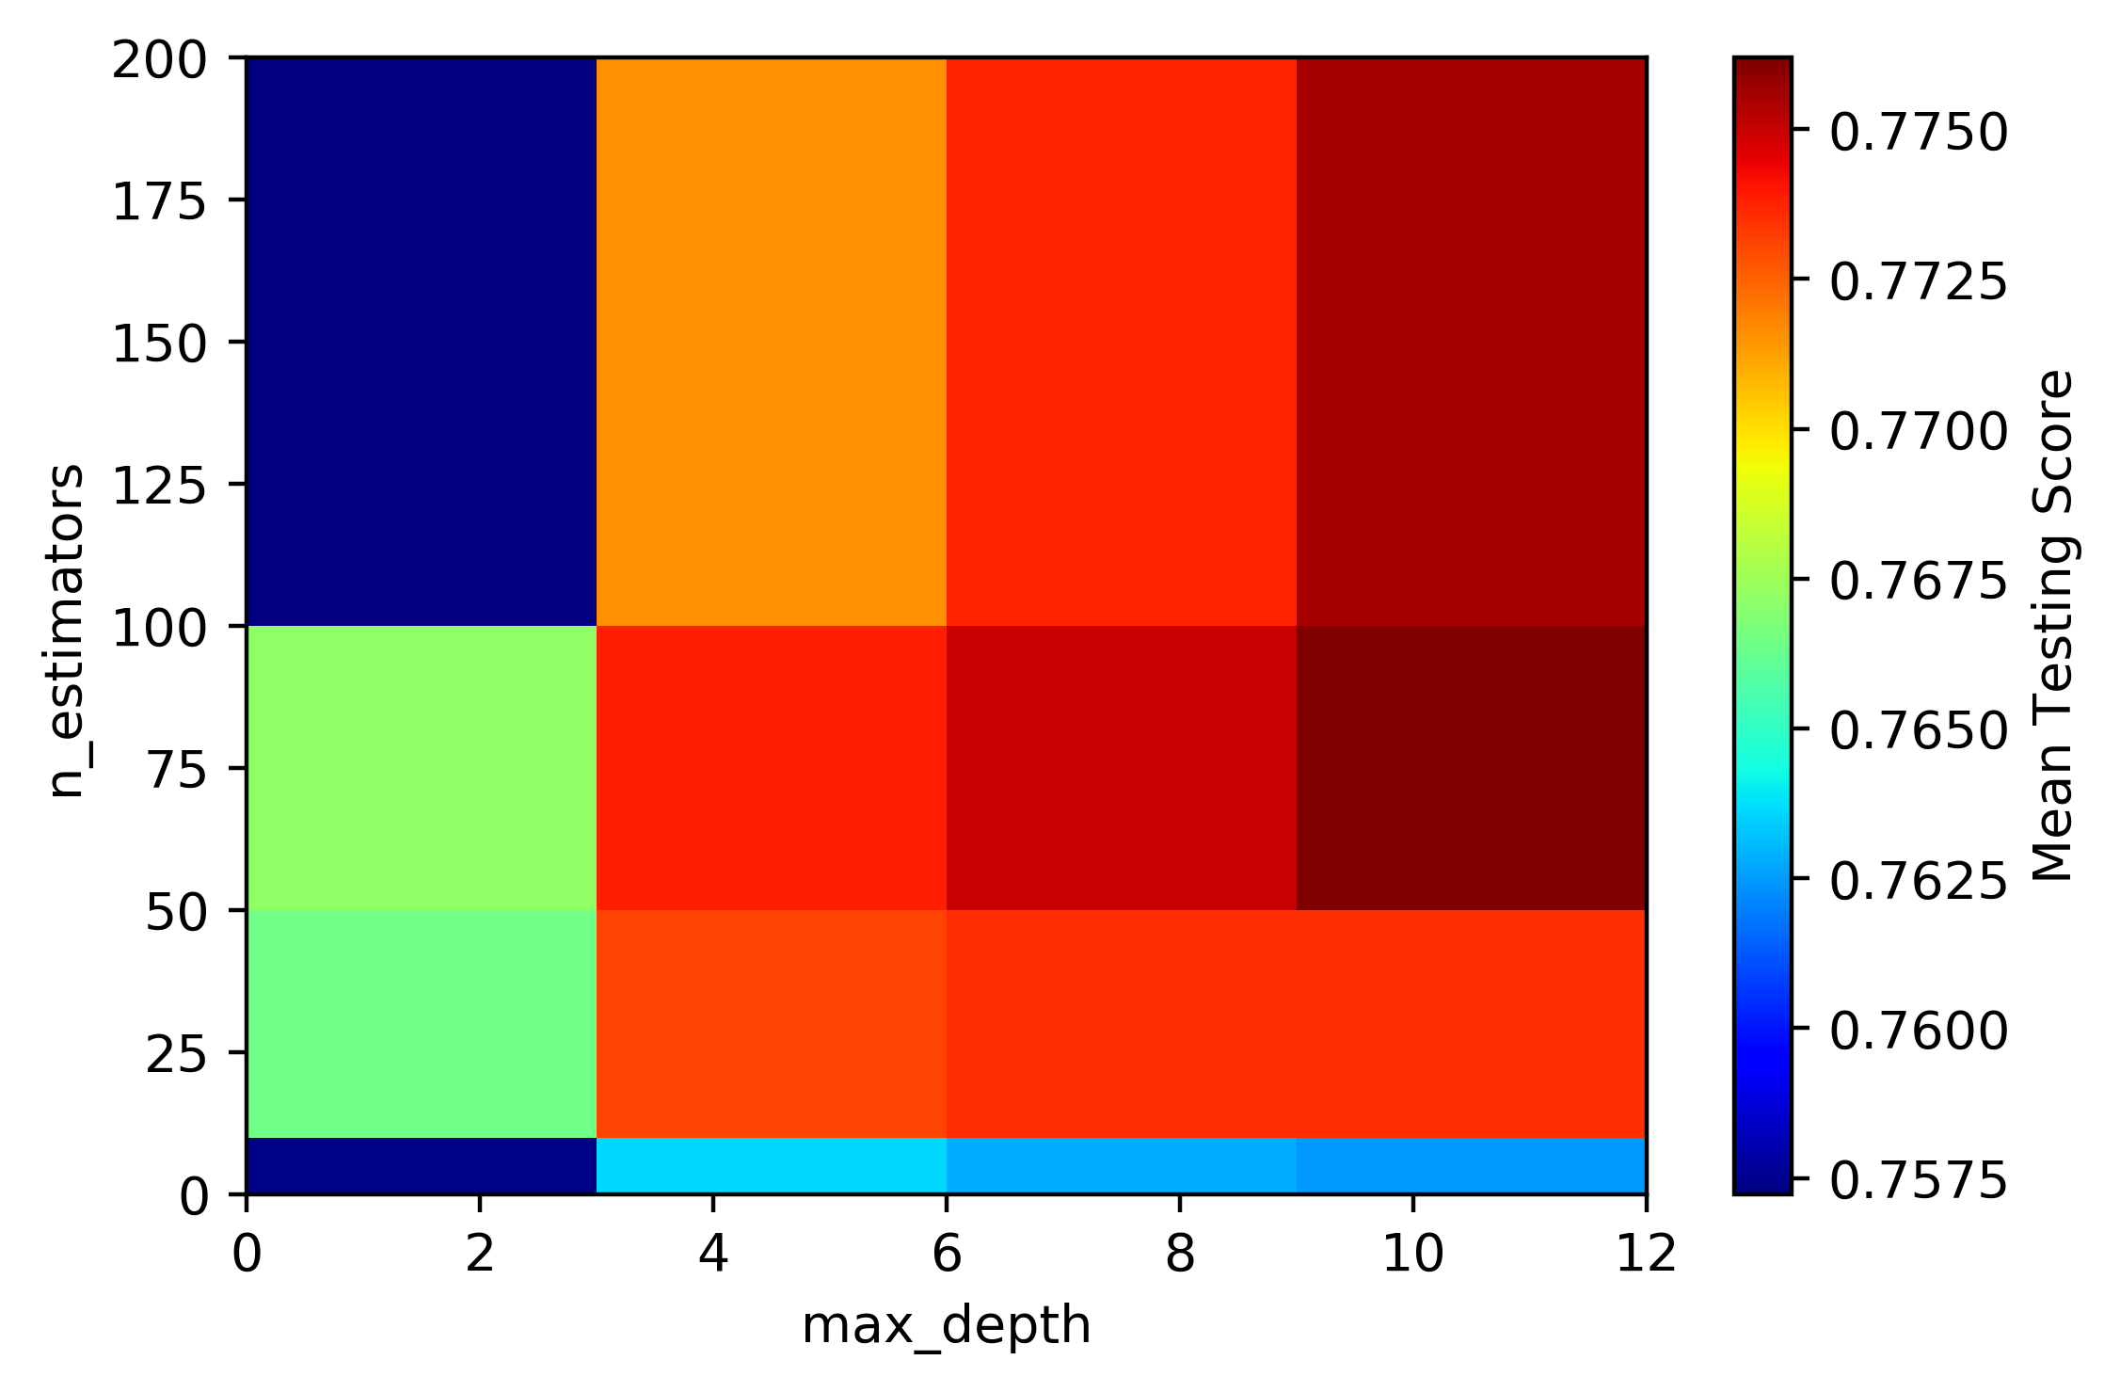
Cross Validation Grid Search with random Forest
Parameters max_depth = 9
& n_estimators = 200 accounts for the highest mean testing score.

Slide 6
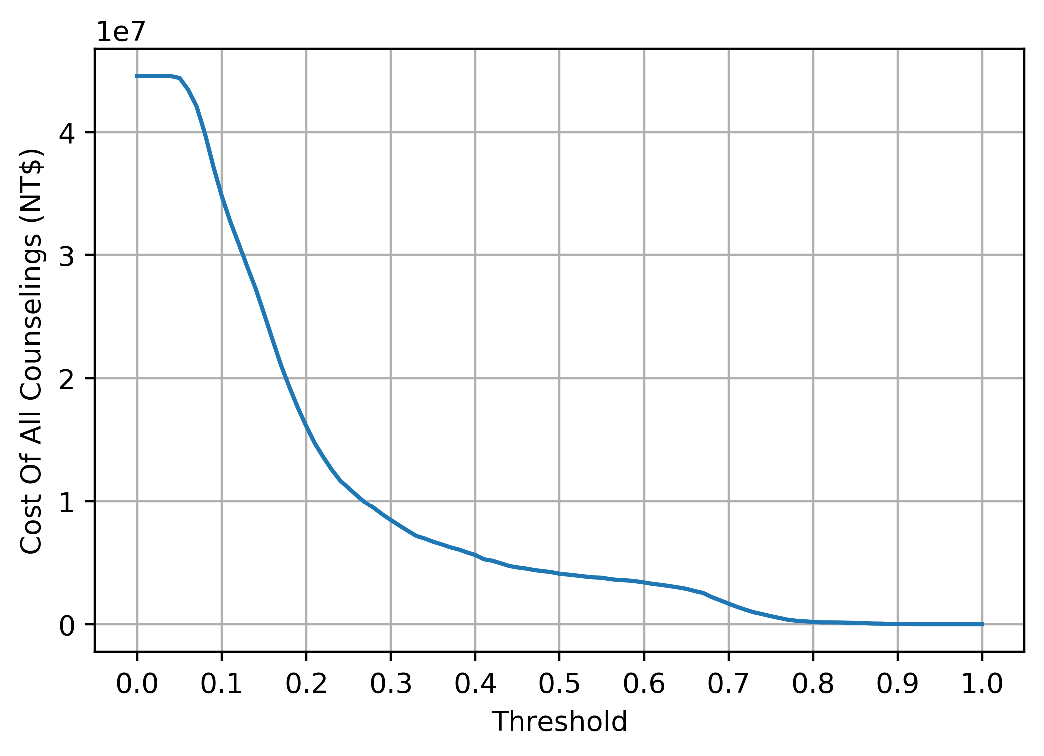
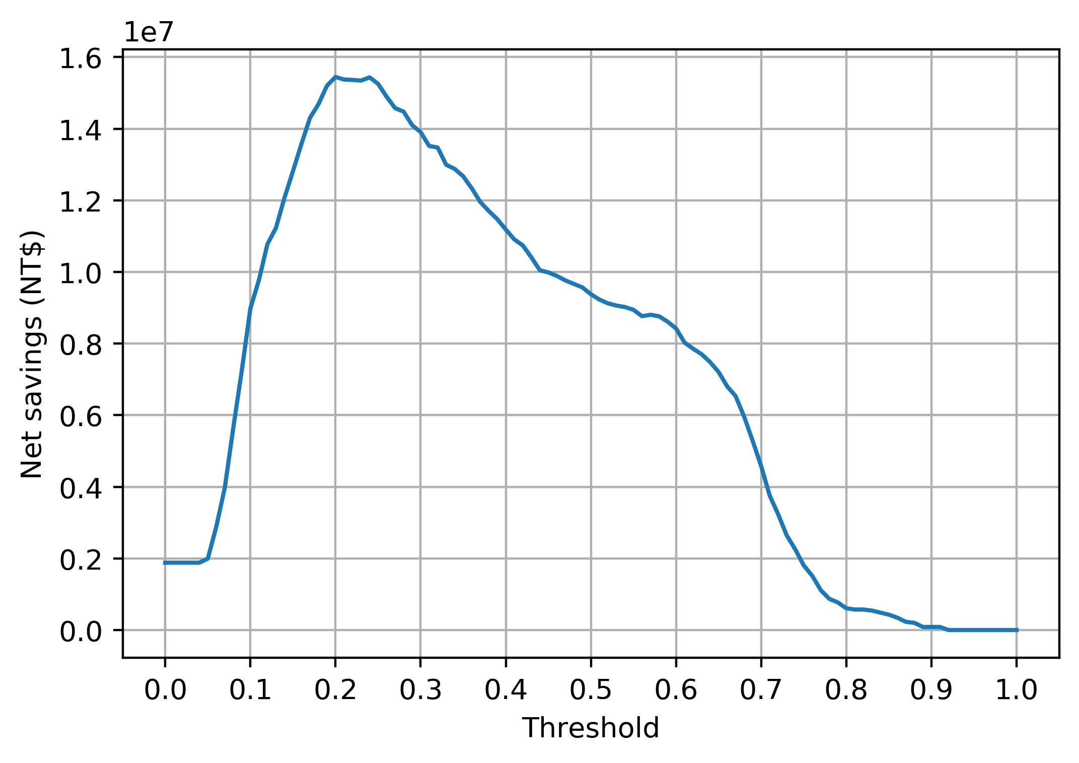
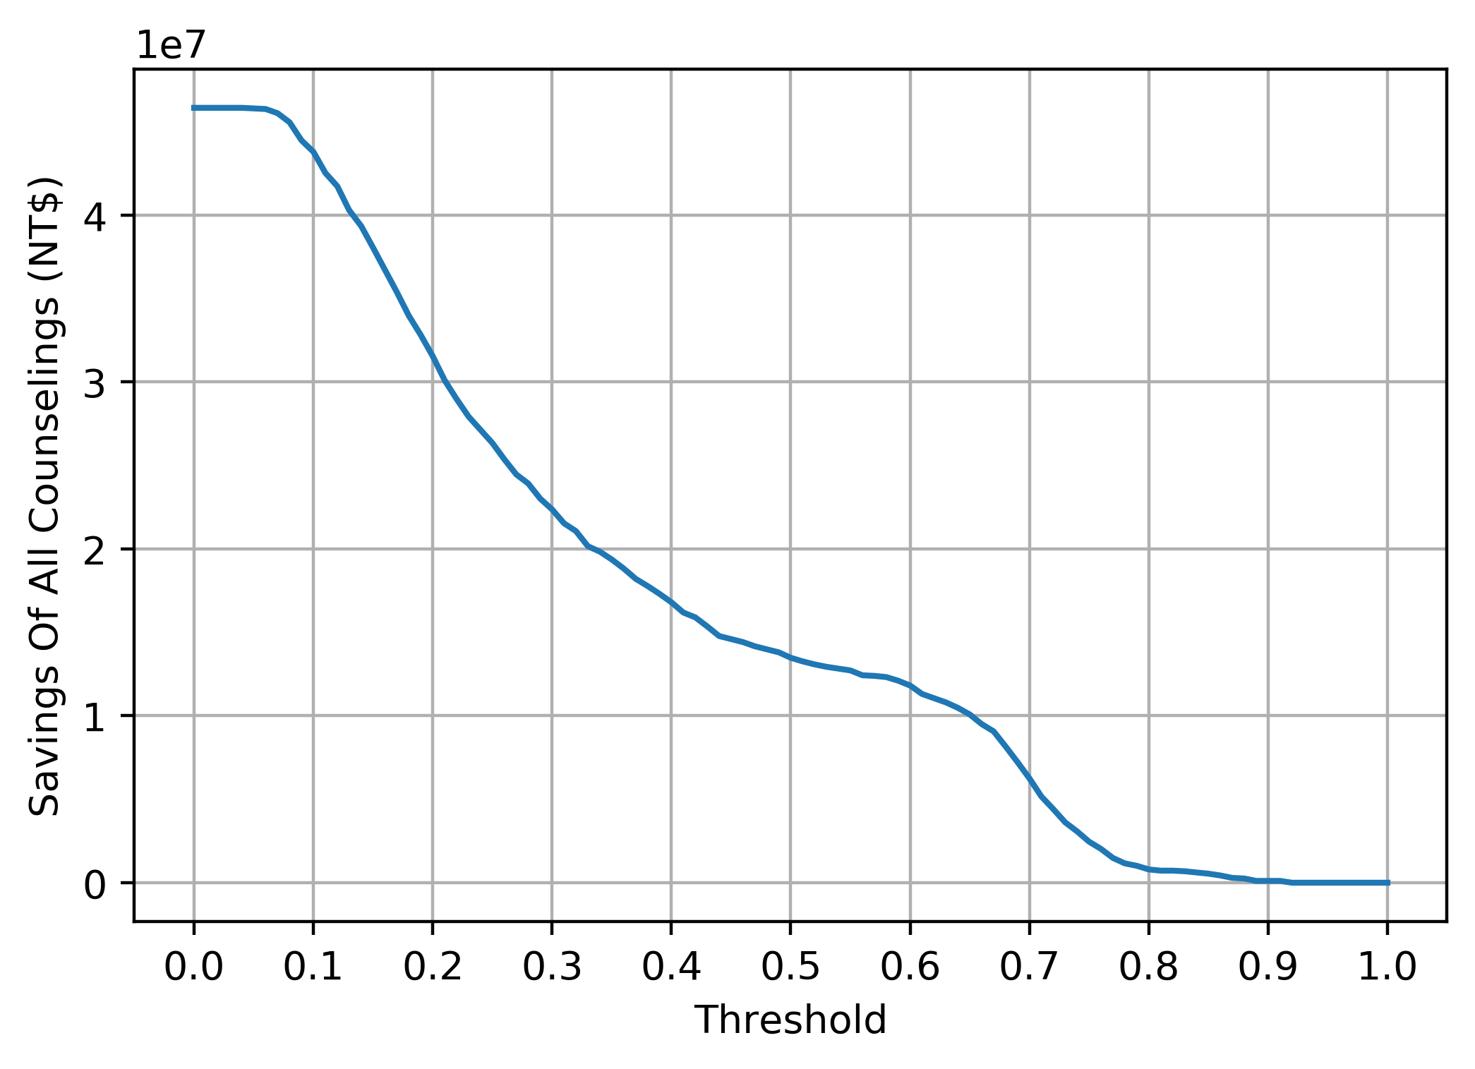
Characterizing Costs and Savings
Most optimal threshold = 0.2

Slide 7
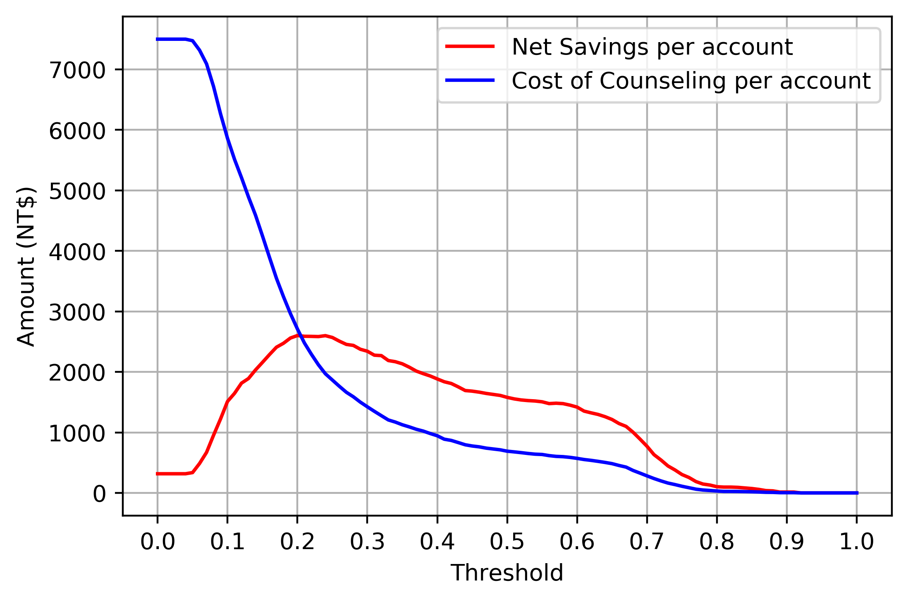
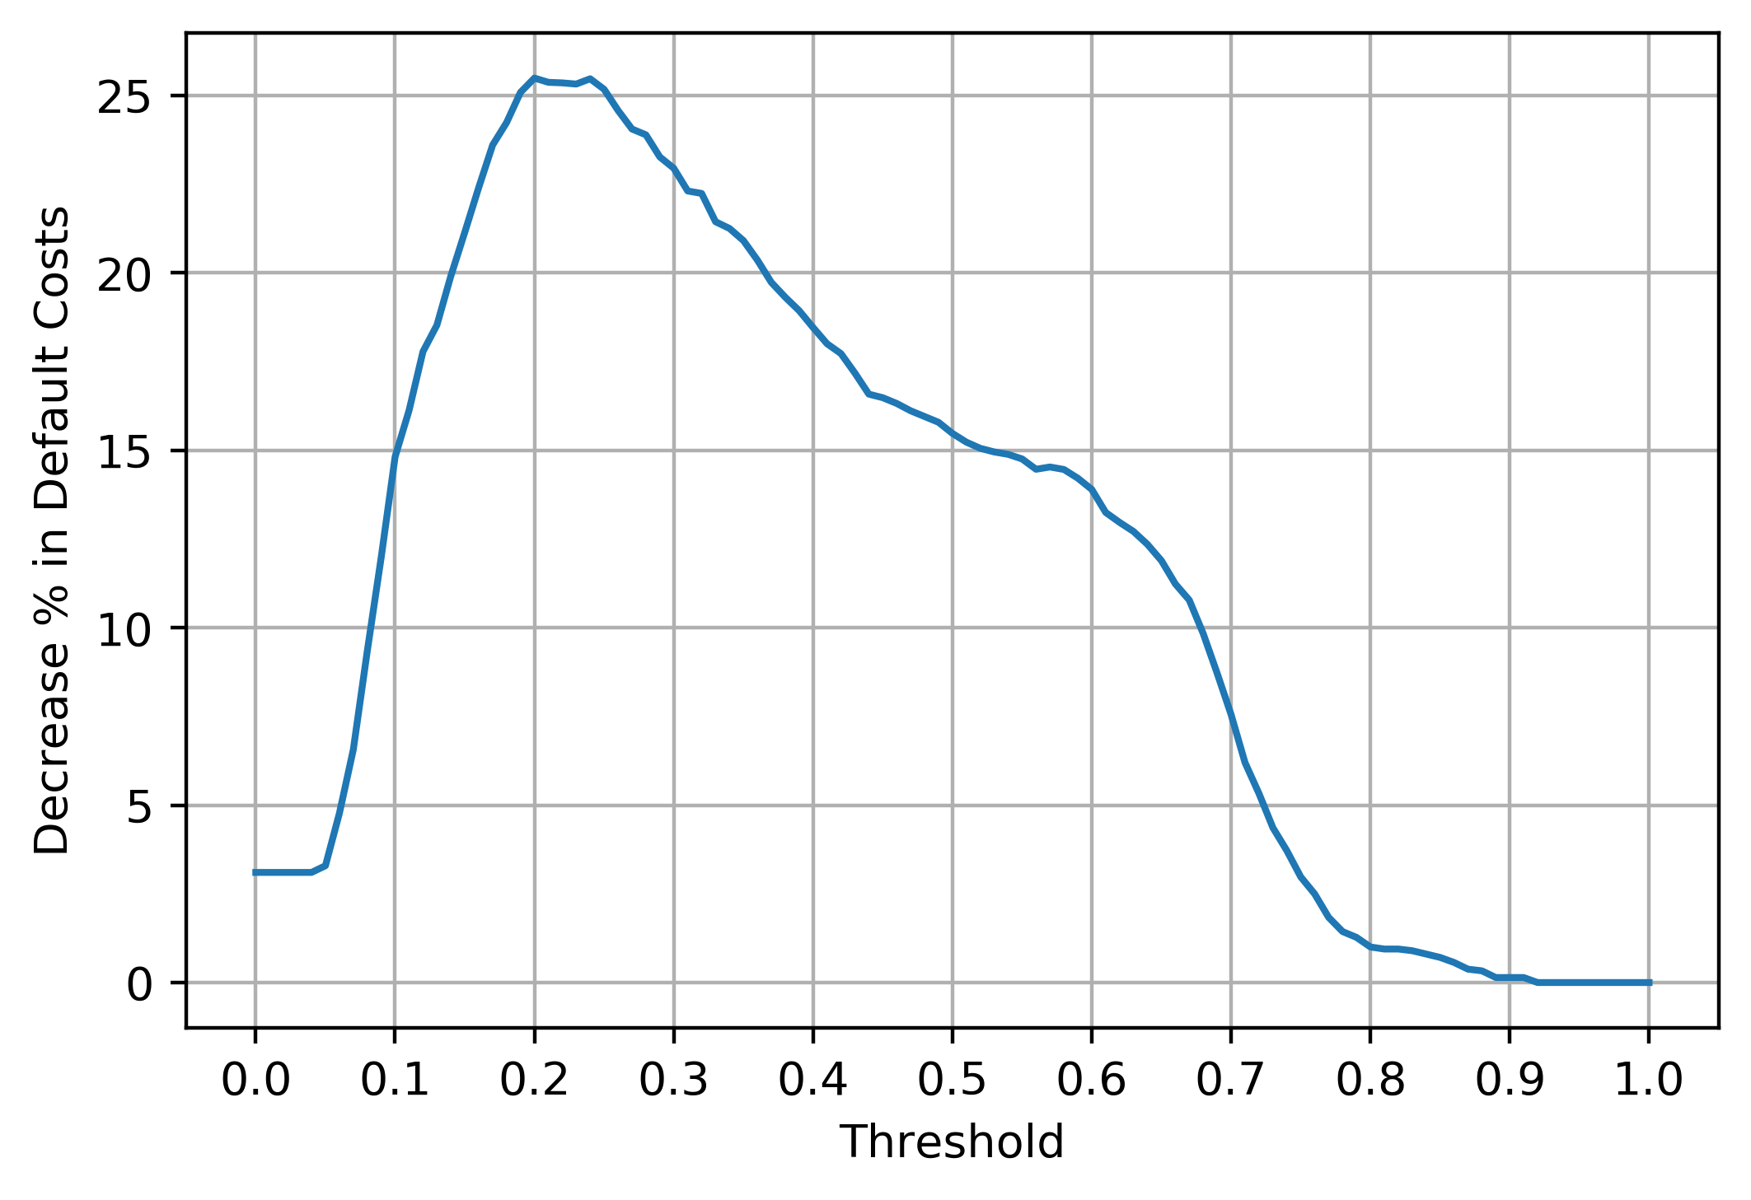
Financial Insights
Using the model at optimal threshold, we are able to save 25-26% cost of all defaults.

Slide 8
Thanks

